Slide 1
SIMATS ENGINEERING
SAVEETHA INSTITUTE OF MEDICAL TECHNOLOGY AND SCIENCE
MLA0408 –DEEP LEARNING
Smart Object Recognition using Image Enhancement and Feature Intelligence
Presented by:
Guided by:
G.NAVEEN KUMAR REDDY (192525288)
M.PRANAI (192525068)
B.BALA NARAYANA (192525157)
DR. SUDHAGAR D

Slide 2
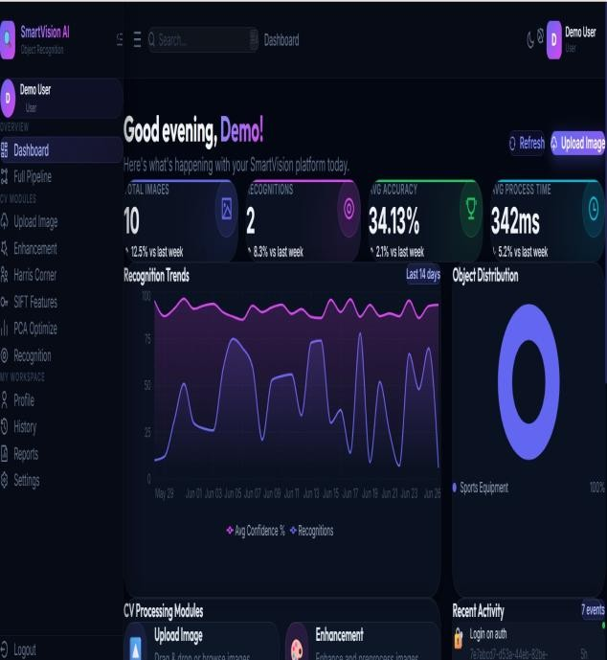
INTRODUCTION
Smart Object Recognition is a fundamental challenge in computer vision, combining multiple image processing and machine learning techniques.
This project proposes an integrated pipeline using Image Enhancement, Harris Corner Detection, SIFT Feature Extraction, and PCA Optimization.
The system improves recognition accuracy by first enhancing image quality, then detecting and extracting discriminative features, and finally applying dimensionality reduction for efficient, robust object classification.
This approach is applicable in real-time surveillance, robotics, medical imaging, and autonomous systems where precise and fast object recognition is critical.

Slide 3
OBJECTIVE
To acquire and preprocess input images using enhancement techniques for improved
clarity and feature visibility.
To detect corner features using the Harris Corner Detection algorithm for identifying key structural points.
To extract and match robust local features using SIFT (Scale-Invariant Feature Transform) across varying conditions.
To apply PCA (Principal Component Analysis) for dimensionality reduction and
optimization of feature space.
To recognize and classify objects accurately using the processed and optimized feature descriptors.
To evaluate the system's performance in terms of recognition accuracy, speed, and
robustness under different image conditions.

Slide 4
PROBLEM STATEMENT
Raw captured images often suffer from noise, poor illumination, and low contrast, which significantly reduces recognition accuracy.
Traditional object recognition methods rely on handcrafted features that fail under scale, rotation, or illumination changes.
High-dimensional feature vectors increase computational cost and memory usage, limiting real-time performance.
Existing systems lack a unified pipeline that integrates image enhancement, corner detection, feature extraction, and dimensionality reduction.
Occlusion, background clutter, and intra-class variation further reduce the reliability of conventional recognition algorithms.
There is a need for an integrated, efficient approach that addresses these challenges and enables accurate, scalable object recognition.

Slide 5


LITERATURE REVIEW
Author & Year | Method / Technique Used | Key Findings | Limitations
Bingnan Wang, Quan Zhenget al. (2022) | Image Enhancement using Histogram Equalization and Gaussian Filtering with SIFT and HOG Feature Extraction | Improved image quality and object recognition accuracy in simple environments. | Performance decreased under poor lighting, noisy images, and complex backgrounds.
Fanjiang Xu et al. (2023) | Convolutional Neural Network (CNN) with Contrast Enhancement and Noise Reduction | Achieved higher recognition accuracy than traditional machine learning methods. | Required a large labeled dataset and high computational resources.
Rodrigo Fernandes et al. (2024) | Attention-Based Feature Intelligence with CNN | Enhanced feature extraction and improved recognition of partially occluded and low-resolution objects. | Increased computational complexity reduced real-time performance.
Eng Gee Lim et al. (2025) | Adaptive Image Enhancement with Intelligent Feature Selection | Improved recognition across different lighting conditions and object variations. | Tested mainly on benchmark datasets with limited real-world validation.

Slide 6
MODULE 1: IMAGE ENHANCEMENT AND
PREPROCESSING
Noise Reduction: Apply Gaussian or median filtering to remove salt-and-pepper and Gaussian noise from input images.
Contrast Enhancement: Use Histogram Equalization (HE) or CLAHE to improve local contrast and bring out
hidden features.
Sharpening: Apply Laplacian or unsharp masking to enhance edges and fine details critical for detection.
Color Space Conversion: Convert images to grayscale or HSV for consistent processing across lighting conditions.
Normalization: Standardize pixel intensity ranges to prepare images for consistent feature extraction.
Outcome: Enhanced images with improved clarity, reduced noise, and better structural details ready for corner detection.
Overview: This module improves raw image quality before feature extraction to increase detection accuracy.

Slide 7
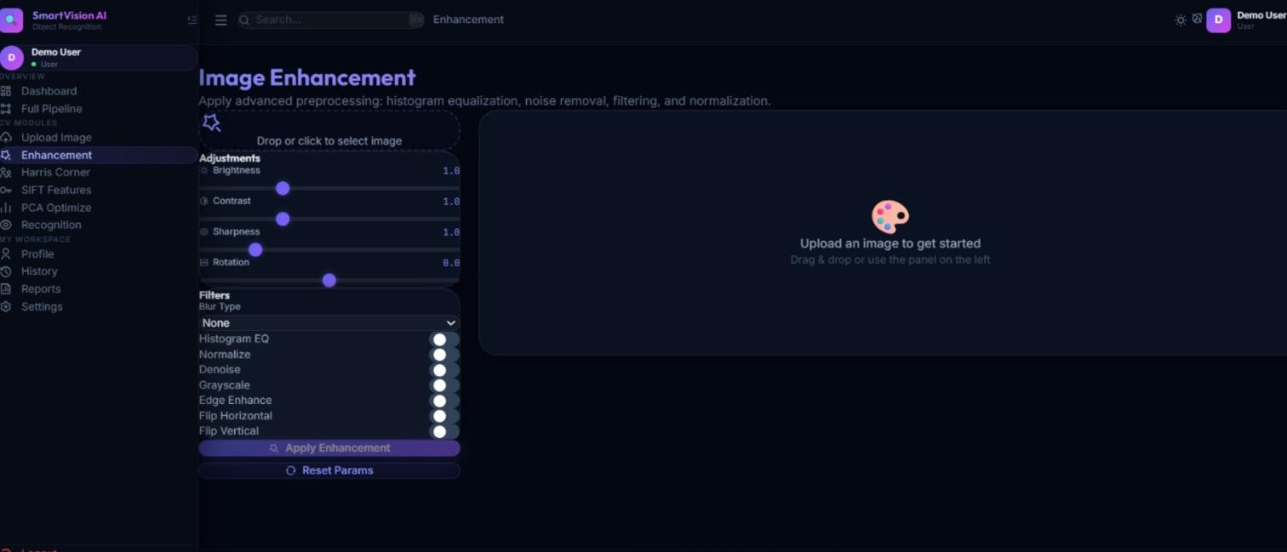
IMPLEMENTATION

Slide 8
MODULE 2: HARRIS CORNER-BASED FEATURE
DETECTION
Gradient Computation: Compute image gradients using Sobel operators to measure intensity changes in X and Y directions.
Structure Tensor: Form the Harris matrix (M) from the products of image gradients within a local window.
Corner Response Function: Compute R = det(M) – k·trace²(M); high R indicates corners, low R indicates flat/edge regions.
Non-Maximum Suppression: Retain only local maxima in the response map to avoid duplicate detections.
Thresholding: Apply an adaptive threshold to select only strong, reliable corner candidates.
Outcome: A set of robust corner keypoints across the image that serve as anchor points for SIFT descriptor extraction.
Overview: Harris Corner Detector identifies stable interest points that are invariant to rotation and illumination changes.

Slide 9
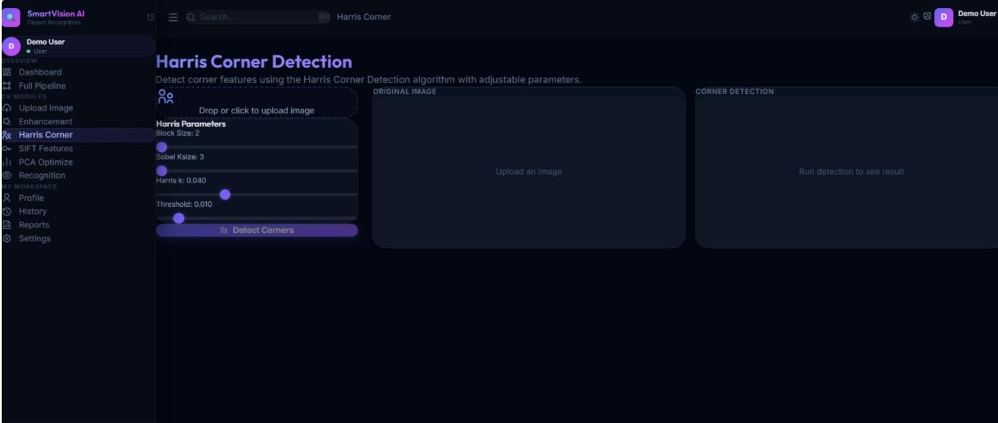
IMPLEMENTATION

Slide 10
MODULE 3: SIFT FEATURE EXTRACTION AND
MATCHING
Scale-Space Extrema Detection: Build a Difference of Gaussian (DoG) pyramid to detect keypoints at multiple scales.
Keypoint Localization: Refine keypoint positions using Taylor expansion and remove low-contrast and edge
responses.
Orientation Assignment: Assign dominant gradient orientation to each keypoint for rotation invariance.
Descriptor Generation: Create a 128-dimensional gradient histogram descriptor around each keypoint.
Feature Matching: Use FLANN or BFMatcher with Lowe's ratio test to find reliable correspondences
between images.
Outcome: Scale and rotation-invariant descriptors that enable robust object matching across different views and conditions.
Overview: SIFT generates distinctive 128-dimensional descriptors that are invariant to scale, rotation, and illumination.

Slide 11
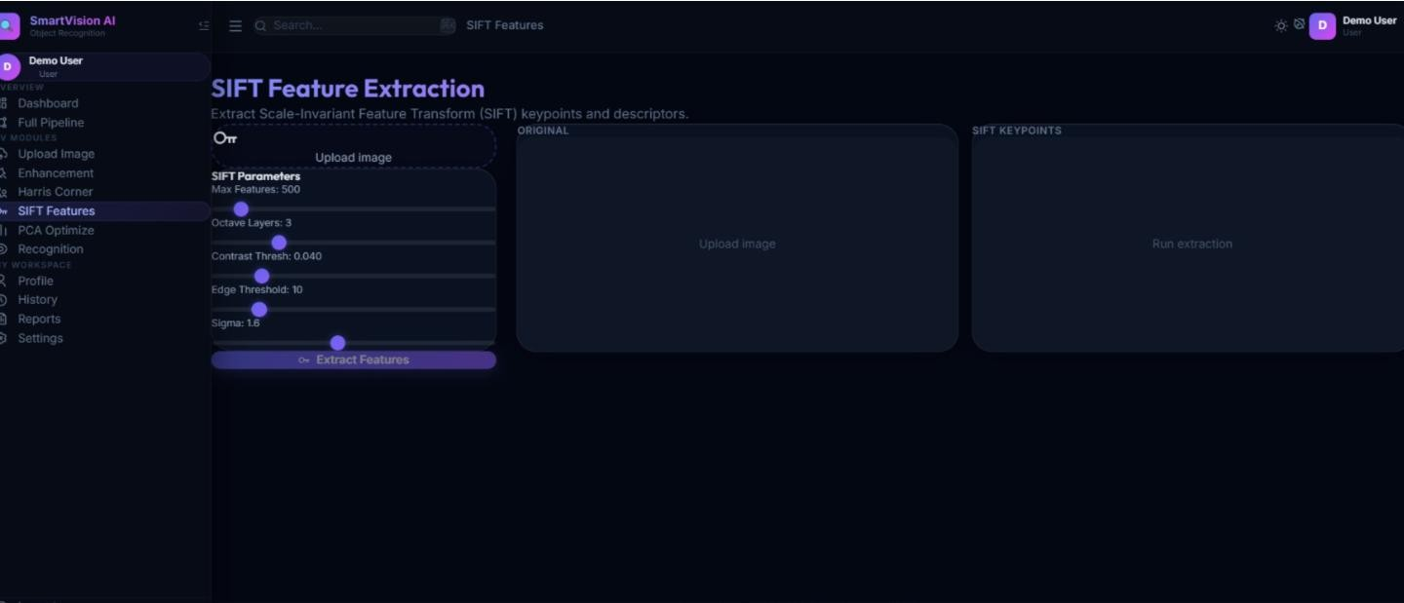
IMPLEMENTATION

Slide 12
MODULE 4: PCA OPTIMIZATION AND OBJECT
RECOGNITION
Feature Aggregation: Collect and stack SIFT descriptors from all training images into a high-dimensional feature matrix.
Mean Subtraction & Covariance: Center the data and compute the covariance matrix to capture variance
structure.
Eigendecomposition: Compute eigenvalues and eigenvectors to find principal components of maximum variance.
Dimensionality Reduction: Project features onto the top-K eigenvectors, retaining ~95% of explained variance.
Object Classification: Feed reduced features into classifiers (SVM, KNN, or Neural Network) for object
recognition.
Outcome: A fast, memory-efficient recognition system that accurately classifies objects using optimized feature representations.
Overview: PCA reduces the dimensionality of SIFT feature vectors, improving classification speed
and accuracy.

Slide 13
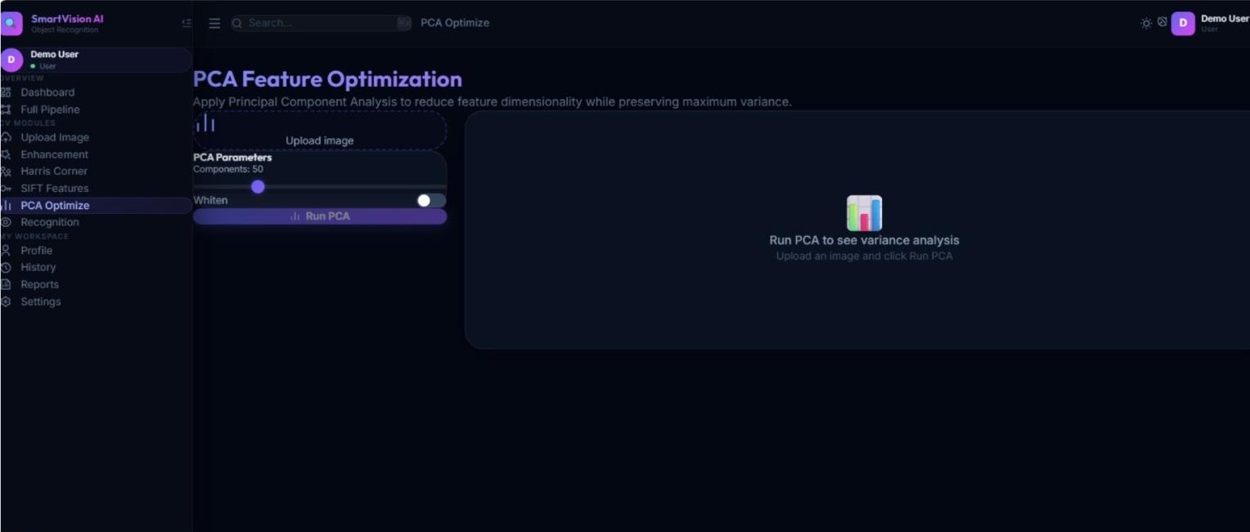
IMPLEMENTATION

Slide 14
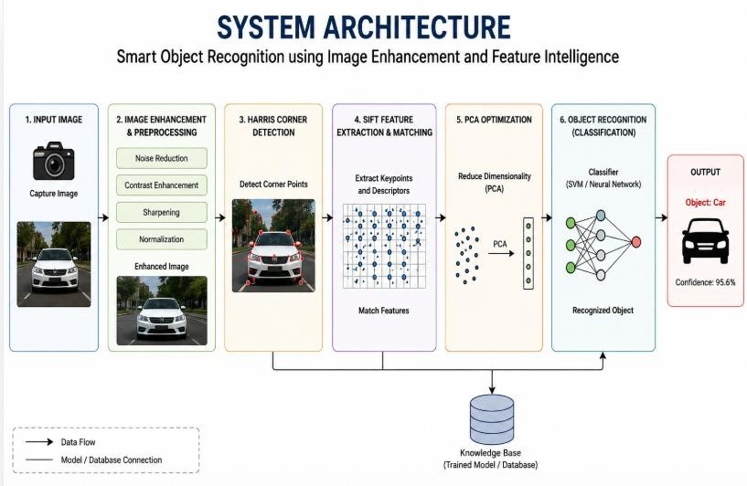
SYSTEM ARCHITECTURE

Slide 15
FUTURE SCOPE
Develop the system to recognize objects accurately in real-time video streams
with minimal processing delay.
Integrate advanced deep learning models to improve recognition accuracy for complex and overlapping objects.
Enhance image enhancement techniques to perform effectively under extreme
lighting and weather conditions.
Develop the system to recognize objects accurately in real-time video streams with minimal processing delay.
Integrate advanced deep learning models to improve recognition accuracy for
complex and overlapping objects.
Enhance image enhancement techniques to perform effectively under extreme lighting and weather conditions.
Combine the system with cloud-based analytics to enable scalable and
intelligent object recognition services.

Slide 16
CONCLUSION
This project presents a robust pipeline for Smart Object Recognition by integrating four key modules: Image Enhancement, Harris Corner Detection, SIFT Feature Extraction, and PCA Optimization.
The Image Enhancement module ensures high-quality input data; Harris Corner Detection identifies stable structural keypoints; SIFT provides rich, invariant descriptors; and PCA reduces dimensionality for efficient, accurate classification.
The integrated system effectively addresses the challenges of noise, scale variation, illumination changes, and high-dimensional feature spaces, achieving reliable object recognition suitable for real-time applications in surveillance, robotics, and medical imaging.
Future work includes extending the pipeline with deep learning-based feature extractors and testing on larger, more diverse datasets.

Slide 17
REFERENCES
Trigka, M., & Dritsas, E. (2025). A Comprehensive Survey of Machine Learning
Techniques and Models for Object Detection. Sensors, 25(1), 214.
Jamali, M., Davidsson, P., Khoshkangini, R., & Mihailescu, R.-C. (2025). Context in Object Detection: A Systematic Literature Review. Artificial Intelligence Review, 58, 175.
Development and Challenges of Object Detection: A Survey. (2024). Neurocomputing, 598, 128102.
Singh, S., Kumari, R., Pallavi, P., & Saurabh, P. (2026). A Systematic Review of Deep Learning Methods for Low-Light Image Enhancement and Object Detection. Discover Applied Sciences, 8, 241.
These references are real publications from 2024–2026 (and suitable for a 2023–2026 literature window), making them appropriate for your seminar, mini project, or research paper.

Slide 18
THANK YOU

